Slide 1
NCCD School Reflection Tool
Staff presentation

Slide 2
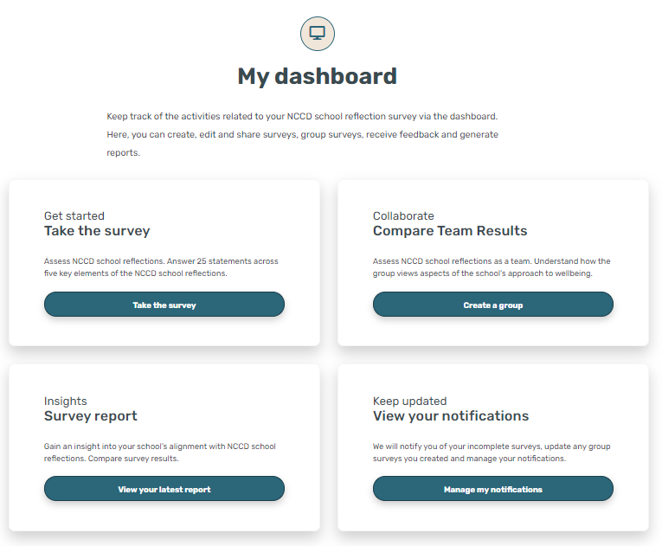
What is the NCCD school reflections survey?
The NCCD school reflection survey helps to review your school’s implementation of the NCCD. It is designed to assist you and your school team to:
evaluate the process as it operates in the school
prompt discussions
consider strengths and potential gaps in knowledge prior to beginning the next year’s data collection process
investigate resources and professional learning to address areas needing attention.

Slide 3
Why is reflection an important part of the NCCD?
As part of the NCCD process, schools should evaluate the application of the NCCD model and consider how school practices and processes could be improved to facilitate next year’s NCCD.
Key areas of consideration for school teams are:
how students with disability are currently being supported
how school teams have completed the NCCD and their understanding of the model
how reflection can assist in planning professional learning requirements for school teams.

Slide 4
Areas of reflection
The survey is designed to:
assist individuals reflect on their knowledge and practice
enable school teams to analyse group survey responses to identify professional learning needs and review internal school processes and practices
compare data collected over subsequent years to assist schools’ continual process improvement plans.
The survey contains 25 statements that encourage you to think about how your school performs across five key elements of the NCCD.
Notes:
Areas of reflection include:
The NCCD process
Collaboration and Communication
Adjustments
Moderation
The Disability Standards for Education (2005)

Slide 5
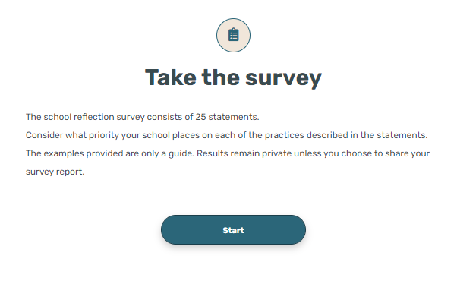
Let’s explore the NCCD school reflection survey
The school reflection survey tool can be used individually or as a whole school (in groups of six or more).
Users will login with their NCCD portal account, or register a new account.
Individually, or with a partner, answer the 25 survey questions (the survey tool can also be used as a larger group – see slide 8).
Users can access their survey results at any time.
Notes:
Navigate to the survey page on the NCCD: https://www.nccd.edu.au/tools/school-reflection-survey-tool
A troubleshooting guide can be found on the above page.
Link directly to the survey tool: https://www.schoolreflectiontool.nccd.edu.au/

Slide 6
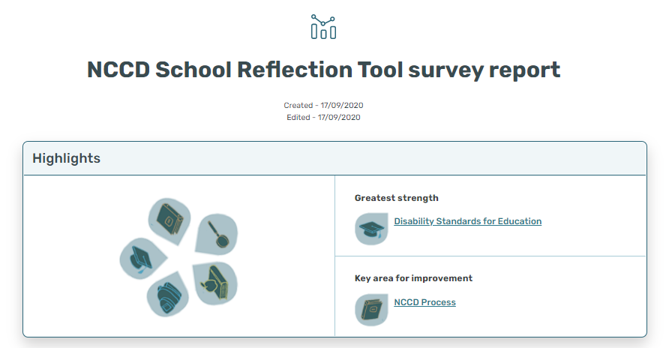
Strengths and areas for improvement
The survey report will show you your, or your group’s, greatest strength and key area for improvement.
These areas are hyperlinked for easy access to the information.

Slide 7
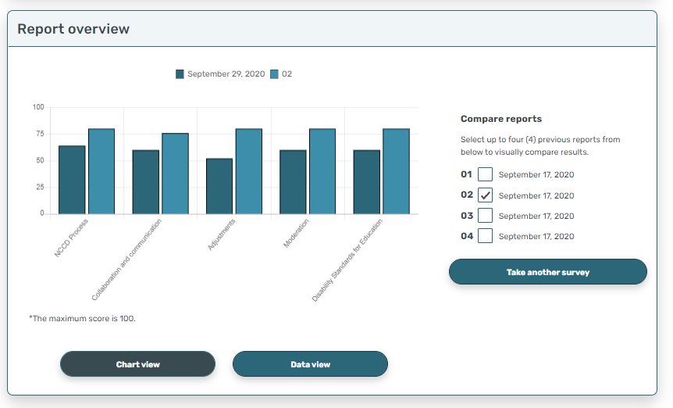
Compare with previous reports
The report overview section allows you to compare your latest report to those completed previously and reflect on your progress in each of the key areas.
This can be shown in chart view or data view, for up to four reports.

Slide 8
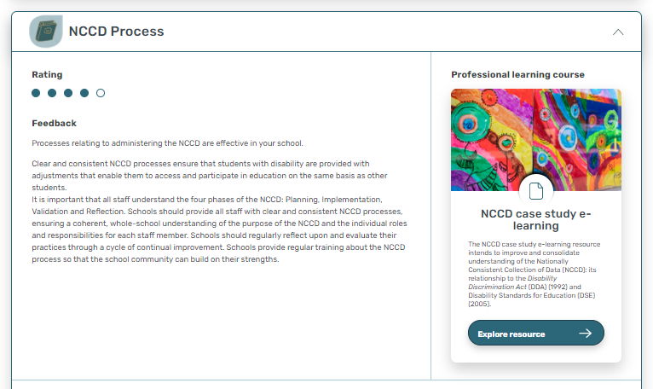
Feedback and suggested resources
Each feedback area will include a rating based on survey responses, access to Professional Learning (if available) and further resources on the NCCD Portal.

Slide 9
Group surveys
A group report can be generated using the Groups function
Elect a group leader.
Gather together six or more participants.
All participants complete the group survey independently (invitation will be emailed using the Groups function of the tool).
Once all participants have completed their surveys, the group can be closed and a survey will be generated.

Slide 10
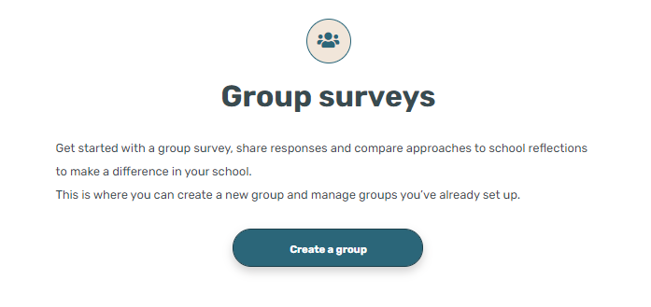
Key priorities for our school
As a group, think about the top three priorities
We will …
We will …
We will …

Slide 11
Next steps?
Further resources regarding school reflection are available on the NCCD portal.

